Slide 1
if…else conditional statement

Slide 2
Objectives
This chapter introduces :
  Basic usage of if…else…
  Use ‘and’ in if…else…
  Use ‘or’ in if…else…

Slide 3
if…else
if…else is a common conditional statement in a programming language
In Python
  if…elif…else statement is used for decision making

Slide 4
if…else
Syntax:
  if (condition 1): #statement 1
  elif (condition 2): #statement 2
  else :
  #statement 3

Slide 5
if…else…
The body of the if (elif, or else) statement is indicated by the indentation
  The body starts with an indentation and ends before the first unindent line
  The body can be a compound statement
    A compound statement is a statement comprise of group of statements

Slide 6

if…else…
E.g:
Result:
  a=15 # Define integer variable a
  b=30 # Define integer variable b
  c=45 # Define integer variable c
  if(a>b):
  print(" Condition 1 hold ")
  elif(b>c):
  print(" Condition 2 hold")
  else:
  print(" Conditions 1 and 2 are invalid")
  print(" Conditions 1 and 2 are invalid")

Slide 7


if…else…
E.g:
Result:
  enter 1: enter 5:
  guess=int (input(" Please guess the number: "))
  #Convert the string to an integer
  if(guess==5):
  print("win")
  else:
  print("lose")

Slide 8
Indentation
In the if...else... statement, different indentation may have different output results

Slide 9
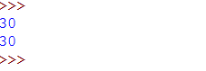
Indentation
E.g1:
Result:
a=15
b=30
if(b>a):
print(b)
else:
print(a)
print(b) #not in if…else
Because b>a is satisfied, output the result under the condition b>a
print (b) that is in the last line of the code is always executed because it is not included in the conditional statement

Slide 10
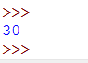
Indentation
E.g2:
Result:
a=15
b=30
if(b>a):
print(b)
else:
print(a)
print(b) #in if...else
Because b>a is satisfied, output the result under the condition b>a

Slide 11
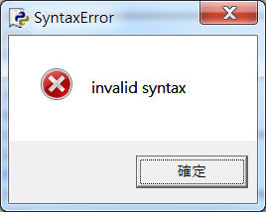
Indentation
E.g3:
Result:
  a=15
  b=30
  if(b>a):print(b)else:print(a)print(b)
  # No indentation will cause an unexpected error

Slide 12
Relational operators
‘and’ and ‘or’ in if…else…
‘and’ and ‘or’ can used to check for multiple conditions in an if statement

Slide 13

‘and’ in if…else
E.g:
Result:
  a = 10
  b = 10
  if ((a> 0) and (b> 0)): # check if multiple conditions are true
  print ("a and b are greater than 0")
  else:
  print ("a, b at least one number not greater than 0")

Slide 14

‘or’ in if…else
E.g:
Result:
  a=10
  b=-1
  if((a>0)or(b>0)):# Check whether one of the conditions is true
  print("a,b at least one of them is greater than 0")
  else:
  print("a,b none greater than 0")

Slide 15
Sources
References:
  http://openhome.cc/Gossip/Python/IOABC.html
  http://www.pythondoc.com/pythontutorial3/introduction.html
  http://pydoing.blogspot.tw/2011/01/python-operator.html
  Python 深入淺出程式設計

Slide 16

Exercise 1
Design a program for the user to enter a score from 0 to 100. The score is displayed according to the following rules:
0 to 59 displays E,
60 to 69 display D,
70 to 79 display C,
80 to 89 points display B,
90 to 100 points display A.
User input :
95
Result :

Slide 17
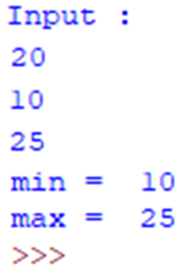
Exercise 2
Design a program that requires the user to enter 3 integers, then display the maximum value and the minimum value of those 3 numbers.

Slide 18
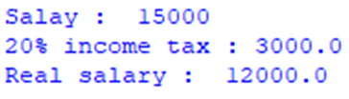
Exercise 3
Design the program that allows the user to enter salary and show the net salary (the remaining salary after tax is deducted) on the screen according to the income tax rules as follows.
  30% income tax if the salary is greater than or equal to 25,000NTD
  20% income tax if the salary is greater than or equal to 10,000NTD and less than 25,000NTD
  10% income tax if the salary is below 10,000NTD
Result :

Slide 19
Exercise 4
Input.txt
1
4
2
5
3
Design a program that will ask the user to input a file name. And then, show the maximum value, minimum value, and mean value of the numbers listed in the file with the given filename.
User input :
  input.txt
Result :
  Minimum value is 1
  Maximum value is 5
  Mean value is 3

